Slide 1
MSc INDIVIDUAL RESEARCH PROJECT · PROGRESS REVIEW
Reliable Migration of Acoustic-Emission Analysis
from MATLAB to Open Source
LLM-assisted translation, exact numerical validation,
and an adaptive event-selection extension
Haoyu Wang · Supervisor and Research Group Update · 15 July 2026
1
Notes:
This presentation summarises the current state of my project on migrating acoustic-emission analysis from MATLAB to open-source computational frameworks. The central question is not whether an LLM can produce Python or Julia syntax. It is whether the translated scientific workflow can be understood, reproduced, and validated strongly enough to support research use. I will first show what the early multi-model experiments taught us, then present the exact MATLAB–Python–Julia validation, and finally discuss the adaptive event-selection extension and the evidence that still needs to be established. The intended outcome of this review is agreement on the remaining scientific scope.本报告总结了我关于将声学发射分析从MATLAB迁移到开源计算框架项目的现状。核心问题不是LLM是否能生成Python或Julia语法。关键在于翻译后的科学工作流程是否能够被理解、复制和验证，以支持科研使用。我将先展示早期多模型实验教给我们的内容，然后展示MATLAB–Python–Julia的具体验证，最后讨论自适应事件选择扩展及仍需建立的证据。本次综述的预期结果是对剩余科学范围达成共识。

Slide 2
The challenge is reliable migration—not translation alone
Legacy constraint
Research requirement
• MATLAB-dependent in-house analysis
• Limited transparency and portability
• Scientific behaviour hidden in implementation details
• Translation errors may remain numerically plausible
An open implementation must preserve the original numerical behaviour, expose assumptions, support reproducible testing, and create a controlled basis for later algorithm development.
Migration is a verification problem before it becomes a software-development problem.
Sources: formal aims and project brief
2
Notes:
The motivation for this project comes from a common problem in scientific computing. A useful analysis workflow exists, but it is tied to a legacy MATLAB implementation. Moving it to Python or Julia could improve openness, reproducibility, and long-term maintainability. However, a translated script can run and produce plausible plots while still being scientifically wrong. Small differences in indexing, window framing, missing-data handling, or library semantics can change the selected events without generating an obvious error. Therefore, the real research problem is reliable migration. The new implementation must preserve the numerical behaviour of the original, document assumptions, and leave an auditable trail. This is especially important for structural-health monitoring, where a silent computational difference may later affect physical interpretation. This framing leads directly to the research questions on the next slide.该项目的动机源自科学计算中常见的问题。存在一个有用的分析工作流程，但它依赖于遗留的MATLAB实现。迁移到Python或Julia可以提升开放性、可重复性和长期维护性。然而，翻译剧本可以运行并产生合理的情节，同时在科学上仍然错误。索引、窗口框架、缺失数据处理或库语义上的细微差别，可以改变所选事件而不会产生明显错误。因此，真正的研究难题是可靠的迁移。新实现必须保留原始的数值行为，记录假设，并留下可审计的痕迹。这对于结构健康监测尤为重要，因为无声的计算差异可能影响物理解读。这种框架直接引出下一张幻灯片中的研究问题。

Slide 3
Four research questions define success
RQ1
RQ2
Can LLMs translate the legacy workflow into readable Python and Julia?
Can the translated outputs be shown numerically equivalent to MATLAB?
RQ3
RQ4
Which failures arise from models, languages, data schemas, or hidden semantics?
Can a verified open framework support a controlled algorithmic extension?
Source: Aims, Objectives & Gantt Chart; MSc project brief
3
Notes:
I have organised the project around four questions. First, can current language models create usable Python and Julia versions of the legacy MATLAB workflow? Second, can those versions be validated at numerical level rather than judged only by visual similarity? Third, when translation fails, can we identify whether the cause is the model, the target language, the data schema, or a hidden MATLAB behaviour? Finally, after exact equivalence is established, can the open implementation support a controlled extension without losing the validated baseline? These questions separate code-generation performance from scientific reliability. They also make the evaluation criteria explicit: readability alone is insufficient, while reproducibility and numerical agreement are essential. This explains why the project moved from broad CT07 translation experiments to a much more focused event-level validation case.我围绕四个问题组织了这个项目。首先，现有的语言模型能否创建可用的Python和Julia版本的遗留MATLAB工作流程？其次，这些版本能否在数字层面进行验证，而不仅仅是通过视觉相似度来判断？第三，当翻译失败时，我们能否确定原因是模型、目标语言、数据模式，还是隐藏的MATLAB行为？最后，在确立精确等价性后，开放实现能否支持受控扩展而不丢失已验证的基线？这些问题将代码生成性能与科学可靠性区分开来。他们还明确了评估标准：仅凭可读性是不够的，而可重复性和数值一致性是必不可少的。这也解释了为什么该项目从广泛的CT07翻译实验转向更聚焦于事件级验证的案例。

Slide 4
Translation, verification and extension are separate stages
1
2
3
4
5
Deconstruct
Translate
Verify
Extend
Evaluate
Inputs, outputs, data flow
Structured LLM prompts
Row-level equivalence
Adaptive threshold, Top-3
Sensitivity and limits
Verification is the gate between translation and extension.
Method derived from the formal project phases
4
Notes:
The methodology follows five stages. I first deconstruct the MATLAB workflow and identify its data flow and assumptions. I then use structured prompts to produce Python and Julia implementations and retain the prompts, responses, and debugging history. The critical third stage is verification: the new languages are compared against exported MATLAB results at event-row level. Only after that gate is passed do I introduce an extension, in this case an adaptive threshold and exploratory Top-3 frequency ranking. The final stage evaluates what the extension changes and, equally importantly, what it does not prove. This sequence creates a traceable chain from legacy behaviour to each later result. It prevents a common error: mixing translation differences with algorithm changes and then being unable to explain the result.该方法论分为五个阶段。我首先拆解MATLAB的工作流，识别其数据流和假设。然后我用结构化提示词生成Python和Julia的实现，并保留提示、响应和调试历史。关键的第三阶段是验证：将新语言与导出的MATLAB结果在事件行层面进行比较。只有在通过该门槛后，我才会引入扩展，在这里是自适应阈值和探索性的前三频率排名。最后阶段评估扩展改变了什么，以及同样重要的是，它不能证明什么。该序列创建了从遗留行为到每个后续结果的可追溯链。它避免了常见错误：将翻译差异与算法变化混淆，导致无法解释结果。

Slide 5
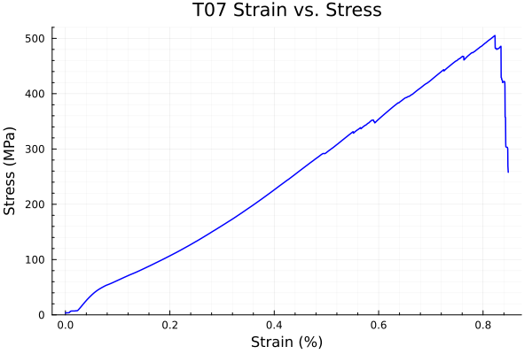
CT07 exposed the limits of one-shot LLM translation
Experiment design
Multiple LLMs and SMOP
Python and Julia targets
Five expected plot types
Prompt, error and repair logs
Outcome
Readable code skeletons were easy to obtain. Reliable spreadsheet ingestion and numerically defensible outputs required human intervention.
Representative stress–strain output produced during the early migration experiments
Source: Preparation Assessment Report, pp. 6–7
5
Notes:
The first major experiment used the CT07 tensile-test workflow. I compared several LLM-generated Python and Julia versions, alongside SMOP, and asked each route to reproduce five expected plot types. The models generally produced readable code structures quickly, and several routes generated visually plausible figures. However, this stage also showed why successful plotting is not sufficient evidence. The main effort was not the plotting code itself; it was understanding the workbook structure, resolving missing-data behaviour, matching columns, and correcting assumptions made by generated code. Python was usually easier to complete, while Julia exposed schema and type problems more directly. SMOP did not produce a dependable complete migration for this workflow. This early experiment established the human-in-the-loop requirement and motivated a narrower validation case with exact outputs.第一个大型实验采用了CT07拉伸试验流程。我比较了多个LLM生成的Python和Julia版本，以及SMOP，并要求每条路径重现五种预期的图类型。这些模型通常能快速生成可读的代码结构，且多条路径生成了视觉上合理的图形。然而，这一阶段也表明了为何成功的绘图并不足以证明。主要工作并非绘制脚本代码本身;这包括理解工作簿结构、解决缺失的数据行为、匹配列以及纠正生成代码所产生的假设。Python通常更容易完成，而Julia则更直接地展示模式和类型问题。SMOP未能为该工作流程提供可靠的完整迁移。这一早期实验确立了“人为参与”的要求，并推动了更狭窄的验证案例，输出精确。

Slide 6
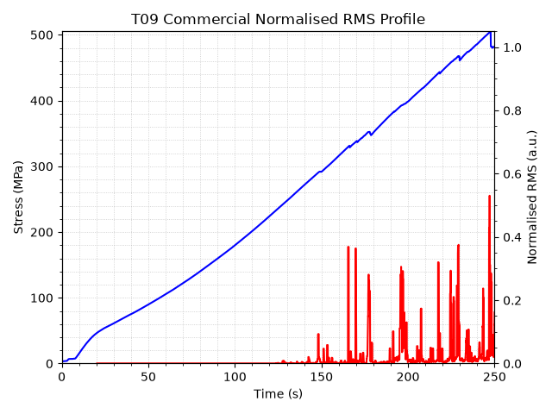
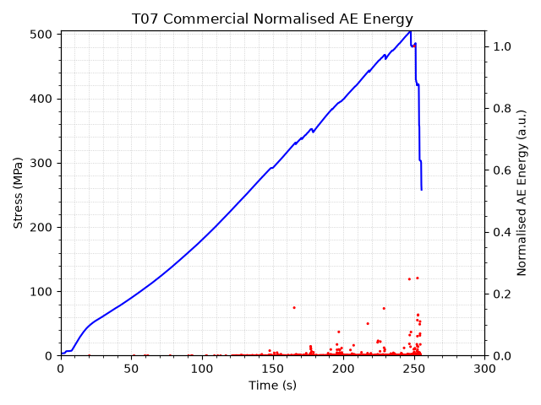
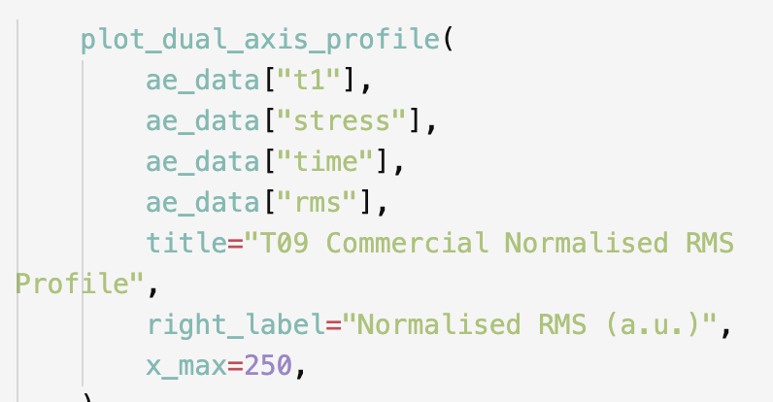
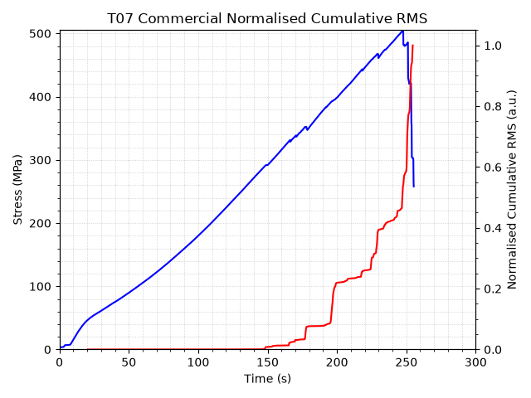
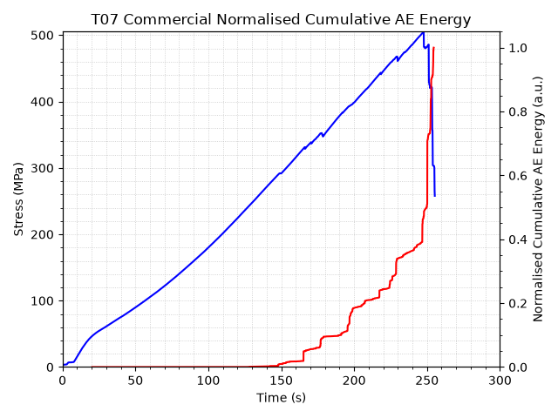
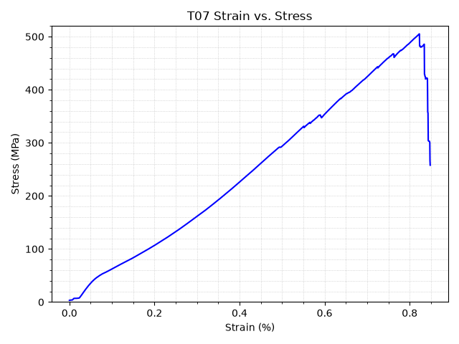
CT07.py outputs

Slide 7
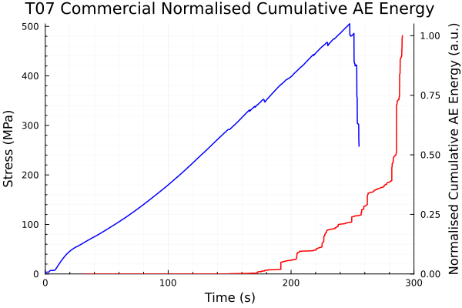
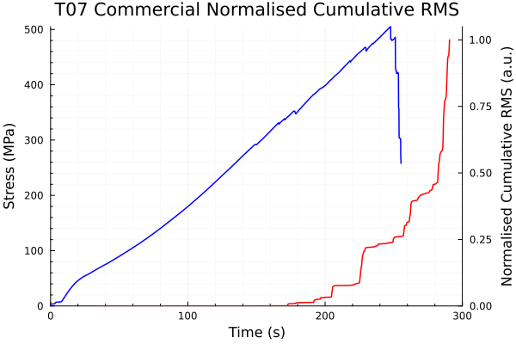
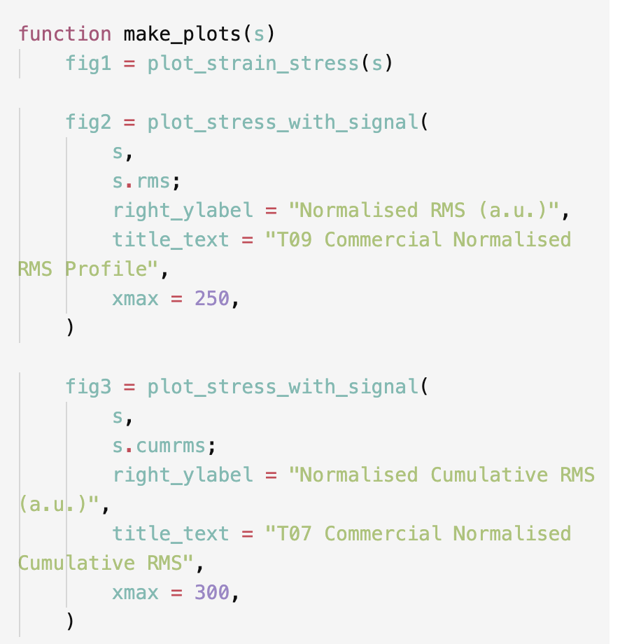
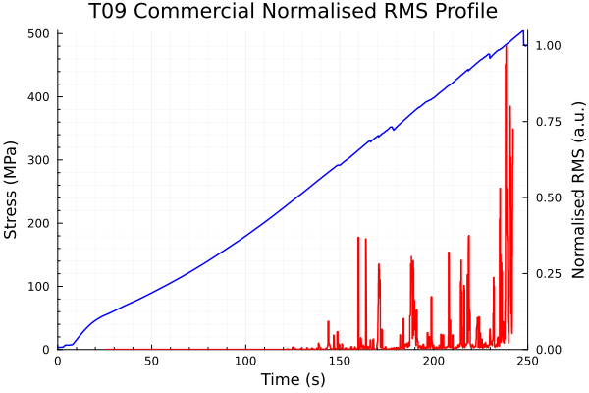
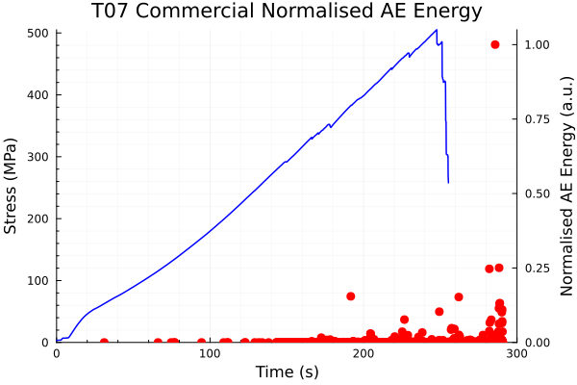
CT07.jl outputs

Slide 8
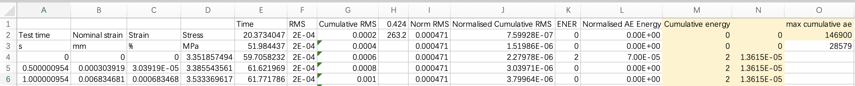
Data ingestion dominated the early failures
Mechanical domain · columns A–D
Why generated code failed
Load, displacement, stress and strain
One valid row range
1. Global drop-na removed valid observations
2. Header and unit rows shifted columns
3. Python and Julia parsers inferred different types
4. Plot success concealed data-selection errors
AE domain · columns E–N
Time, RMS and energy features
A different valid row range
Lesson: validate the data contract before evaluating model-generated analysis code.
Source: workbook inspection and AE development notes
6
Notes:
The most important CT07 lesson was that the workbook is not one rectangular scientific table. The mechanical variables occupy one domain and the acoustic-emission variables occupy another, with different valid row ranges. A global missing-value operation can therefore remove legitimate data or create false alignment. Several generated scripts also interpreted header rows, units, and numeric columns differently. This explains why a plot can look reasonable even when the data selection is wrong. The practical response was to inspect the schema explicitly and use validated CSV intermediates where necessary. This is not merely an engineering detail: in scientific migration, the data contract is part of the algorithm. It also provides a concrete example of an LLM failure that is plausible rather than syntactically obvious. To obtain a stronger numerical test, I therefore selected a workflow with simpler inputs and exact event-level outputs. CT07最重要的课程是，练习册不是一张矩形的科学表格。机械变量占据一个域，声发射变量占据另一个域，有效行范围不同。因此，全局缺失值操作可能会删除合法数据或造成错误对齐。多个生成脚本还对头行、单位和数字列进行了不同的解释。这也解释了为什么即使数据选择错误，图看起来依然合理。实际做法是明确检查模式，并在必要时使用经过验证的CSV中间体。这不仅仅是工程细节：在科学迁移中，数据合同是算法的一部分。它还提供了一个合理的大型语言模型失败实例，而非语法上显而易见的。为了获得更强的数值检验，我选择了输入更简单、事件级输出更精确的工作流程。

Slide 9
Peak_Freq.m enables event-level numerical validation
CT07 workflow
Peak_Freq.m workflow
Experiment-scale summaries
Stress, strain, RMS and energy plots
Complex spreadsheet schema
Useful for translation behaviour
Raw MAT waveforms → RMS windows → FFT peaks
Exact event indices and numeric columns
Direct MATLAB export available
Suitable for row-by-row equivalence
The two workflows are complementary, but their specimen and time mapping is not yet established.
Sources: Peak_Freq development log; CT07 workflow notes
7
Notes:
Peak_Freq.m became the main validation case because it has a clearer computational chain. It reads raw waveform files, centres the signal, calculates moving RMS windows, selects candidate events, and extracts a dominant FFT peak. The output can be exported from MATLAB as exact event indices, times, frequencies, and magnitudes. That allows a row-by-row comparison rather than a judgement based on figures. It also makes silent one-sample indexing errors directly observable. CT07 and Peak_Freq remain complementary: one describes experiment-scale mechanical and AE summaries, while the other analyses raw waveform windows. At present I have not established a defensible specimen and absolute-time mapping between them. I therefore keep the workflows separate in the implementation and integrate their interpretation only after the mapping has been validated. Peak_Freq.m 成为主要的验证案例，因为它拥有更清晰的计算链。它读取原始波形文件，中心化信号，计算移动的有效值窗口，选择候选事件，并提取主导的FFT峰值。输出可以从 MATLAB 导出为精确事件索引、时间、频率和强度。这使得可以逐排比较，而不是仅凭数据做出判断。它还使得静默的单样本索引错误可以直接观察到。CT07和Peak_Freq保持互补：前者描述实验规模的机械和AE总结，后者分析原始波形窗口。目前我尚未建立出可辩护的样本和它们之间的绝对时间映射。因此，我在实现中保持工作流程分开，只有在映射验证后才整合它们的解释。

Slide 10
Exact replication required MATLAB framing semantics
1 MHz
200
0.1
Top-1
Sample rate
Samples per window
Fixed RMS threshold
Strongest FFT peak
Hidden semantic difference
MATLAB starts with a zero-padded frame [0, 1, …, 199] and discards the final padded column. Matching this behaviour corrected the event-index offset in both open-source implementations.
Source: AE Peak-Frequency Development Log
8
Notes:
The legacy algorithm uses a one-megahertz sampling rate, two-hundred-sample windows, a fixed RMS threshold of zero-point-one, and the strongest valid FFT peak. These parameters were straightforward to identify. The difficult part was reproducing MATLAB's framing semantics. The original combination of moving RMS and buffer operations starts with a zero-padded frame whose indices correspond to zero followed by samples one through one-hundred-and-ninety-nine. The final padded column is then discarded. A conventional Python or Julia window loop begins at a different position, producing a persistent event-index offset even when the frequencies look similar. Once both implementations reproduced the MATLAB framing exactly, the row structure aligned. This shows why library-level semantics must be tested rather than inferred from documentation alone. It was the decisive root-cause correction behind the validation result.遗留算法采用一兆赫采样率、两百个采样窗口、固定的有效值阈值零点一，以及最强的有效FFT峰值。这些参数很容易识别。难点在于重现MATLAB的框架语义。最初移动RMS和缓冲操作的组合从一个零填充帧开始，其索引对应于零，随后是样本1到199。最后一列填充的列则被丢弃。传统的Python或Julia窗口循环从不同位置开始，即使频率相似，也会产生持续的事件索引偏移。一旦两个实现完全重现了MATLAB的帧，行结构就对齐了。这说明了为什么库级语义必须被测试，而非仅凭文档推断。这是验证结果背后的决定性根本原因纠正。

Slide 11
All 3,098 T01 results agree across three languages
42
3,098
10⁻¹²
All numeric rows match MATLAB within tolerance.
T01 MAT files
rows in each language
relative and absolute tolerance
Platform
Rows
Event indices
Time error
Frequency error
Magnitude error
MATLAB
3,098
Reference
—
—
—
Python
3,098
Identical
0.0 s
0.0 kHz
5.68×10⁻¹³
Julia
3,098
Identical
0.0 s
0.0 kHz
5.68×10⁻¹³
Source: legacy_row_comparison_summary.json
9
Notes:
This is the strongest verified result in the project. The comparison covers forty-two T01 MAT files. MATLAB, Python, and Julia each produce exactly three-thousand-and-ninety-eight rows. The event indices are identical. The maximum time error and peak-frequency error are both zero. The maximum peak-magnitude difference is approximately five-point-six-eight times ten to the minus thirteen, and every numeric row passes relative and absolute tolerances of ten to the minus twelve. The current test suites also pass: nineteen Python tests and five Julia test groups cover input handling, adaptive selection, Top-3 ranking, and MATLAB-compatible framing. The comparison uses exported numeric records, so it is independent of plotting style or image resolution. This evidence supports a precise claim: the legacy T01 workflow has been reproduced in both open-source languages.这是该项目中最强有力的经验证结果。比较涵盖了42个T01 MAT文件。MATLAB、Python 和 Julia 各自生成恰好三千零九十八行。事件指数是相同的。最大时间误差和峰值-频率误差均为零。最大峰值-星等差约为5.68乘以10的负13次方，每一行数值都通过十的负十二的相对和绝对容差。现有测试套件也通过了：19个Python测试和5个Julia测试组涵盖输入处理、自适应选择、前三排名和兼容MATLAB的框架。比较使用导出的数值记录，因此不受绘图风格或图像分辨率的影响。这些证据支持了一个精确的说法：遗留的T01工作流程已被两种开源语言复制。

Slide 12
Adaptive thresholds isolate the effect of event selection
Legacy selection
Adaptive selection
First-file centring and extrema
Fixed RMS threshold = 0.1
Same rule propagated across the group
Top-1 FFT peak
Per-file signal centring
Threshold = median + 8 × 1.4826 × MAD
Same 200-sample framing and FFT baseline
Optional Top-3 peaks, separated by ≥20 kHz
Controlled comparison: selection changes; the baseline spectral calculation does not.
Top-3 remains exploratory.
Sources: implementation plan and experiment plan
10
Notes:
After the legacy behaviour was verified, I introduced one focused extension. The legacy method uses centring and extrema derived from the first file and a fixed RMS threshold of zero-point-one. The adaptive method centres each file independently and calculates a robust threshold from the median and median absolute deviation of its RMS values. The window length, MATLAB-compatible framing, and baseline FFT peak calculation remain unchanged. This makes the comparison interpretable: the main experimental variable is event selection. The robust statistic was chosen to respond to file-specific noise without being dominated by extreme samples. I also implemented an optional Top-3 frequency ranking with a minimum twenty-kilohertz separation, but that feature is exploratory. At this stage I do not claim that additional peaks correspond to distinct damage mechanisms. The immediate question is how the adaptive selection changes coverage across the full dataset.在遗留行为被验证后，我引入了一个聚焦扩展。传统方法使用中心化和从第一个文件导出的极值值，以及固定的零点一的有效值阈值。自适应方法独立中心化每个文件，并从其有效值的中位数和绝对偏差中位数计算出一个稳健阈值。窗口长度、MATLAB兼容的帧和基线FFT峰值计算保持不变。这使得比较具有可解释性：主要实验变量是事件选择。选择稳健统计量是为了应对文件特异的噪声而不被极端样本主导。我还实现了一个可选的前三频率排名，间距至少为20千赫，但那只是探索性功能。目前我并不认为额外的峰值对应不同的损伤机制。当前的问题是自适应选择如何改变整个数据集的覆盖率。

Slide 13
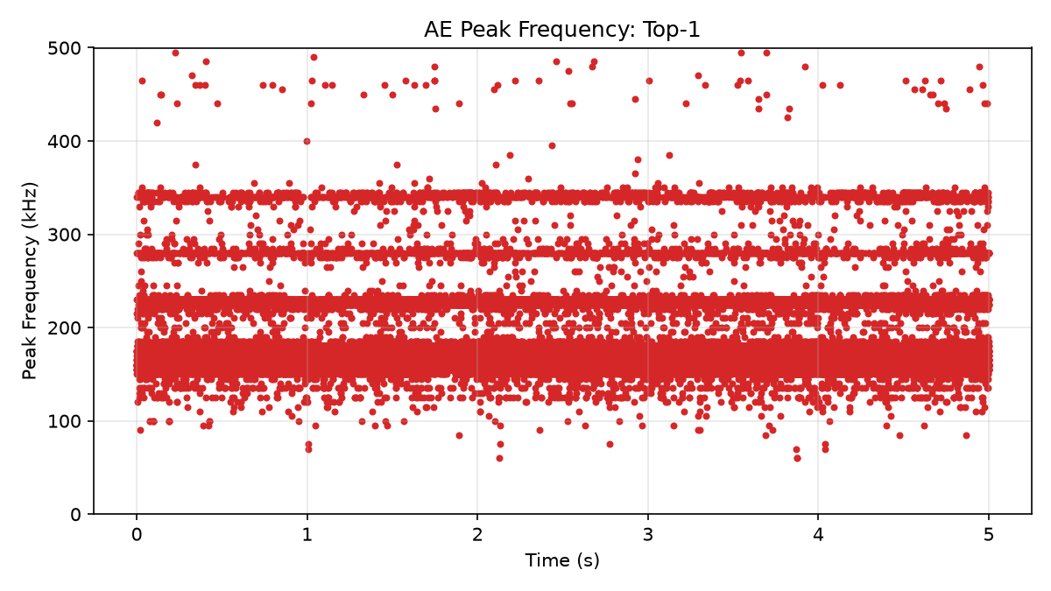
Revalidation covers 377 files and 11.37 million windows
9
test groups · T01–T09
377
MAT waveform files
11.37M
candidate windows evaluated
Representative T01 adaptive Top-1 frequency output
Source: t01_t09_comparison_summary.csv
11
Notes:
The adaptive comparison was then expanded from the initial case to all nine available groups, T01 through T09. The current revalidation covers three-hundred-and-seventy-seven MAT waveform files and more than eleven-point-three-six million candidate windows. The plot shown here is a representative T01 adaptive Top-1 result. It illustrates the dense frequency bands found in the data, particularly around the main one-hundred-and-sixty to one-hundred-and-seventy-five kilohertz region, together with additional higher-frequency bands. The important point is the scale and consistency of the experiment: both legacy and adaptive selection were evaluated using the same framing and spectral baseline across every group. Outputs include CSV results, plots, and run metadata for each group. That allows the coverage differences on the next slide to be calculated from a single reproducible summary.随后，适应性比较从初始病例扩展到所有九个可用组，即T01至T09。当前的重新认证涵盖了377个MAT波形文件和超过1360万个候选窗口。这里展示的图是一个代表性的T01自适应Top-1结果。它展示了数据中发现的密集频带，特别是在主要的160至175千赫兹区域附近，以及额外的高频频段。关键在于实验的规模和一致性：所有组都使用相同的框架和谱基线评估了遗留选择和自适应选择。输出包括CSV结果、图表和各组的运行元数据。这使得下一张幻灯片的覆盖差异可以从单一可重复的摘要中计算出来。

Slide 14
Adaptive selection retains every legacy event—
and finds 32.16× more candidates
Adaptive-to-legacy selection ratio by group
16,240
legacy-selected windows
522,216
adaptive Top-1 rows
16,240 / 16,240
legacy windows retained
Source: t01_t09_comparison_summary.csv
12
Notes:
Across all nine groups, the legacy method selected sixteen-thousand-two-hundred-and-forty windows. The adaptive implementation produced five-hundred-and-twenty-two-thousand-two-hundred-and-sixteen Top-1 rows, an overall ratio of thirty-two-point-one-six. The ratio varies substantially by group, from approximately eighteen-point-six in T09 to ninety-six-point-five in T08. Most importantly, every one of the sixteen-thousand-two-hundred-and-forty legacy-selected windows is also selected by the adaptive method, after correcting the MATLAB buffer mapping. No legacy-selected window is missing. One T09 legacy-selected window has no valid FFT peak, which is why the legacy result table has sixteen-thousand-two-hundred-and-thirty-nine rows. The variation between groups indicates that a single global threshold interacts strongly with file-level signal conditions. These results demonstrate sensitivity and coverage; they do not yet demonstrate that all additional windows are physical AE events.在这九组中，传统方法共选出了16,240个窗口。自适应实现产生了522,216行Top-1，总比为32.16行。这一比例因群体而异，T09约为18.6，T08为96.5。最重要的是，在修正MATLAB缓冲区映射后，自适应方法也选择了16240个遗留窗口中的每一个。没有遗留选择的窗口缺失。一个T09遗留选择窗口没有有效的FFT峰值，这也是遗留结果表有16,239行的原因。组间的差异表明单一全局阈值与文件级信号条件有强烈相互作用。这些结果显示了灵敏度和覆盖率;但尚未证明所有额外的窗口都是物理的AE事件。

Slide 15
The evidence shows sensitivity—not physical accuracy
Proven
Not yet proven
Research implication
• All legacy-selected windows are retained
• Adaptive selection is active in every file
• More candidate windows are selected
• Main frequency centres remain broadly stable
• Additional windows are true AE events
• Accuracy improved by 32.16×
• Top-3 peaks identify damage mechanisms
• Results transfer directly to steel structures
The next experiment must inspect representative adaptive-only windows and connect them to waveform, RMS, FFT and mechanical context.
Sensitivity is a result. Accuracy requires ground truth.
Interpretation based on the T01–T09 comparison
13
Notes:
This slide draws the boundary between evidence and interpretation. The data prove that adaptive selection retains every legacy-selected window, operates in every file, and selects many more candidates while the broad frequency centres remain stable. The data do not prove that all additional windows are genuine acoustic-emission events. They also do not justify describing the thirty-two-point-one-six ratio as an accuracy improvement. The Top-3 extension has not yet been linked to specific damage mechanisms, and the present composite tensile case does not automatically establish transfer to steel structures. A defensible accuracy claim would require labelled events, independent sensing evidence, or a validated mechanical-stage relationship. The next scientific step is therefore not another threshold variant. It is a targeted inspection of adaptive-only windows across low, medium, and high activity conditions, including the raw waveform, RMS trace, FFT spectrum, and available mechanical context.这张幻灯片划定了证据与解释之间的界限。数据证明，自适应选择保留了所有遗留选择的窗口，在每个文件中运作，并且在广泛的频率中心保持稳定的情况下，选择了更多的候选者。数据并不能证明所有额外的窗户都是真实的声学发射事件。他们也无法为将32.16比描述为准确率提升辩护。Top-3延伸尚未与具体损伤机制相关联，现有复合拉伸案例也未自动确定对钢结构的转移。可辩护的准确性主张需要标记事件、独立的感测证据或经过验证的机械阶段关系。因此，下一步科学步骤不是另一个阈值变异。它是针对仅自适应窗口在低、中、高活动条件下的有针对性检查，包括原始波形、均方根迹、FFT频谱及可用机械上下文。

Slide 16
The technical core is strong; interpretation remains the main risk
Current strengths
Open limitations and risks
Exact cross-language evidence
Reproducible code, tests and exports
Documented failures and repair history
Controlled selection-method comparison
Full T01–T09 revalidation
Steel project scope vs composite validation data
No confirmed mechanics–waveform time mapping
Adaptive-only events lack physical ground truth
Top-3 scientific value remains untested
Controlled performance benchmark is incomplete
The project risk is now scope and interpretation—not code availability.
Sources: project status review and validation records
14
Notes:
The project now has a strong technical core. The exact cross-language evidence is reproducible, the implementation is covered by tests, and both successes and failures have been documented. The adaptive experiment also changes the event-selection gate while preserving the validated FFT baseline, which makes the comparison interpretable. The main risks have shifted. The formal title emphasises steel structures, whereas the deeply validated T01–T09 case is composite tensile data. The mechanical and raw-waveform records are not yet aligned in absolute time. Adaptive-only events lack physical ground truth, Top-3 has not demonstrated scientific value, and the Python–Julia–MATLAB performance comparison is not yet controlled. The remaining work should therefore prioritise validity over additional functionality. These are manageable risks, but only if the remaining scope is frozen and prioritised deliberately.该项目现在拥有了强大的技术核心。精确的跨语言证据可复现，实现过程通过测试覆盖，成功与失败均有记录。自适应实验还改变了事件选择门，同时保留已验证的FFT基线，使比较过程更具可理解性。主要风险已经发生变化。正式名称强调钢结构，而经过深度验证的T01–T09案例则是复合拉伸数据。机械波和原始波形记录尚未绝对时间对齐。仅自适应事件缺乏物理真实性，Top-3尚未证明科学价值，Python–Julia–MATLAB的性能比较尚未被控制。因此，剩余的工作应优先考虑有效性而非额外功能。这些风险是可控的，但前提是剩余范围被冻结并有意识地优先排序。

Slide 17
Validate events, align data and freeze scope
Current conclusion
A legacy MATLAB AE workflow has been reproduced exactly in Python and Julia. The adaptive extension is promising, but its additional detections require physical validation.
01
02
03
Validate events
Align records
Freeze scope
Sample adaptive-only windows and inspect waveform, RMS and FFT evidence.
Confirm specimen and absolute-time mapping between waveform and mechanics.
Agree the steel/composite framing, finish controlled benchmarks, and integrate the dissertation.
Immediate decision requested: confirm the material scope and validation priority.
Progress review · 15 July 2026
15
Notes:
In conclusion, the project has moved beyond demonstrating that LLMs can generate scientific code. It now contains a validated migration case in which MATLAB, Python, and Julia agree at event-row level within a strict numerical tolerance. The adaptive extension retains all legacy-selected windows and greatly increases candidate coverage, but the additional detections still require physical interpretation. I propose three immediate priorities. First, validate representative adaptive-only windows using waveform, RMS, and FFT evidence. Second, establish the specimen and absolute-time relationship between raw waveform files and mechanical records. Third, freeze the dissertation scope by agreeing how the formal steel focus relates to the current composite validation case, then complete only the controlled benchmarks needed for the final argument. This would preserve the strongest contribution while keeping the remaining work achievable before final submission. The main decision I need from this meeting is that scope and validation priority.总之，该项目已超越了展示大型语言模型能够生成科学代码的阶段。它现在包含一个经过验证的迁移案例，其中MATLAB、Python和Julia在事件行层面在严格的数值容忍范围内达成一致。自适应扩展保留所有旧有选择的窗口，并大幅提升候选覆盖范围，但额外的检测仍需物理解读。我提出三个紧迫的优先事项。首先，利用波形、有效根和FFT证据验证代表性仅自适应窗口。其次，建立原始波形文件与机械记录之间的样品和绝对时间关系。第三，通过达成正式钢铁焦点与当前复合验证案例的关系来冻结论文范围，然后只完成最终论证所需的受控基准。这样既能保留最强的贡献，又能在最终提交前完成剩余的工作。我从这次会议中最需要做出的决定是范围和验证的优先级。

